Slide 1
1 mil
S1
19 mil
All signal traces and ground planes have thickness 1mil
G2
19 mil
G3
19 mil
G4
19 mil
G5
19 mil
G6
19 mil
G7
19 mil
G8
19 mil
S9

Slide 2
2*R_{via}
2*R_{via}
1 mil
S1
19 mil
All signal traces and ground planes have thickness 1mil
G2
C_{via}
19 mil
G3
19 mil
G4
L_{via}
19 mil
G5
19 mil
G6
R_{via}
19 mil
G7
19 mil
G8
19 mil
S9
2*R_{Anti}

Slide 3
S1
G2
C_{via}
G3
G4
L_{via}
G5
G6
R_{via}
G7
G8
S9

Slide 4
 | mil
Via radius | 20
Anti Radius | 40 -> ???
Trace Width | 43 (Q3D result)
Metal thickness | 1
Trace pitch (trace_d) | 120

Slide 5
R_{r}
L₁₁
Differential
R_{r}
L₂₂
Differential
C₁₁
C₂₂

Slide 6
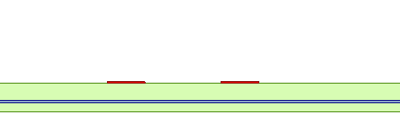
W_{PCB}
D_{PCB}
W_{PCB}
T_{PCB}
H_{PCB}

Slide 7
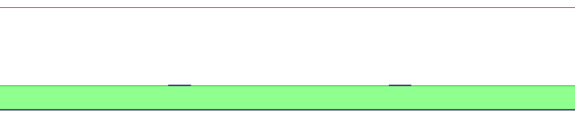
W_{PKG}
D_{PKG}
W_{PKG}
T_{PKG}
H_{PKG}

Slide 8
Traditional DFE
Half-delayed DFE
Differential input
Differential input
+
D_{out}
+
D_{out}
x Tap1
x Tap1
delay half clock period 0.5 T
Z⁻¹
x Tap2
x Tap2
Z⁻¹
Z⁻¹
x Tap3
x Tap3
Z⁻¹
Z⁻¹

Slide 9
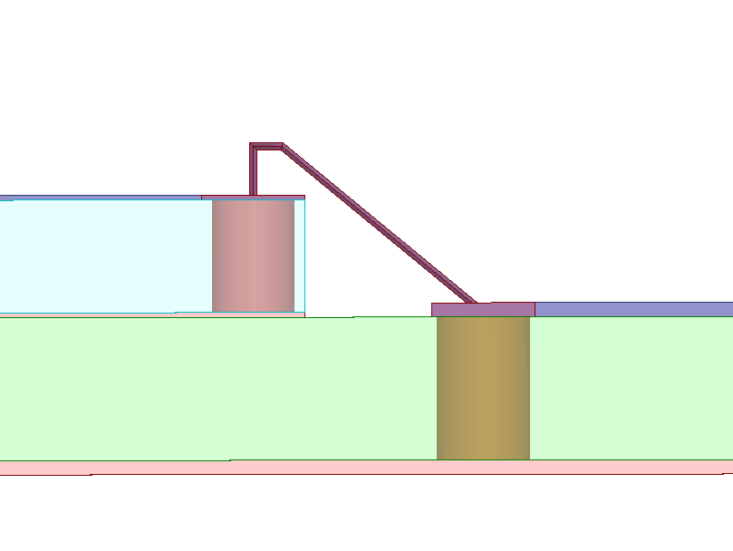
L_{wire}
T_{PKG}
H_{wire}
2R_{wire}
H_{PKG}
T_{PCB}
L_{gap}
T_{PKG}
2R_{PKG}
H_{PCB}
2R_{PCB}

Slide 10
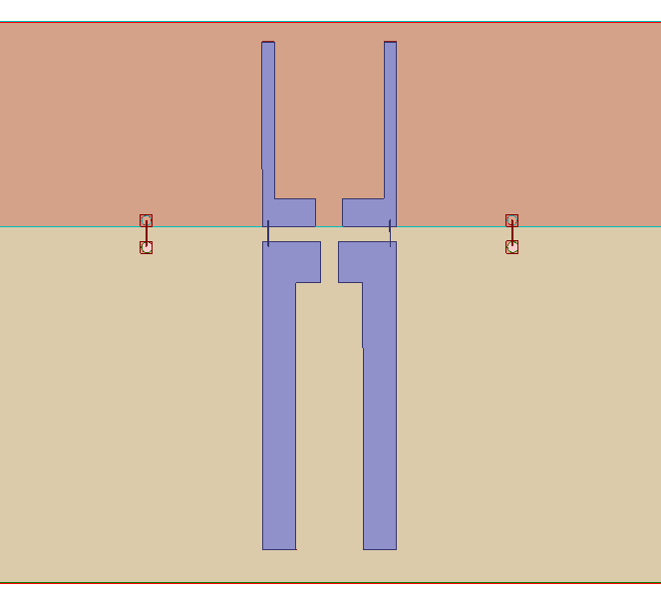
W_{PKG}
D_{PKG}
W_{PKG}
Port 3
Port 4
L_{PKG}
W₁
G_{PKG}
L₁
L_{gap}
L_{PAD}
L₂
W_{PAD}
W₂
L_{PCB}
Port 1
Port 2
W_{PCB}
D_{PCB}
W_{PCB}

Slide 11
Tx
Rx
Port A
Port B
Port C
50
FFE (Verilog)
Diff
Channel
DFE (Verilog)
PRBS31
(Verilog)
50
Clk w/ Jitter (Verilog)
Diff
Channel
Clk

